Slide 1
Ratios
Textbook: Business Mathematics by Gary Clendenen and Stanley Salzman

Slide 2
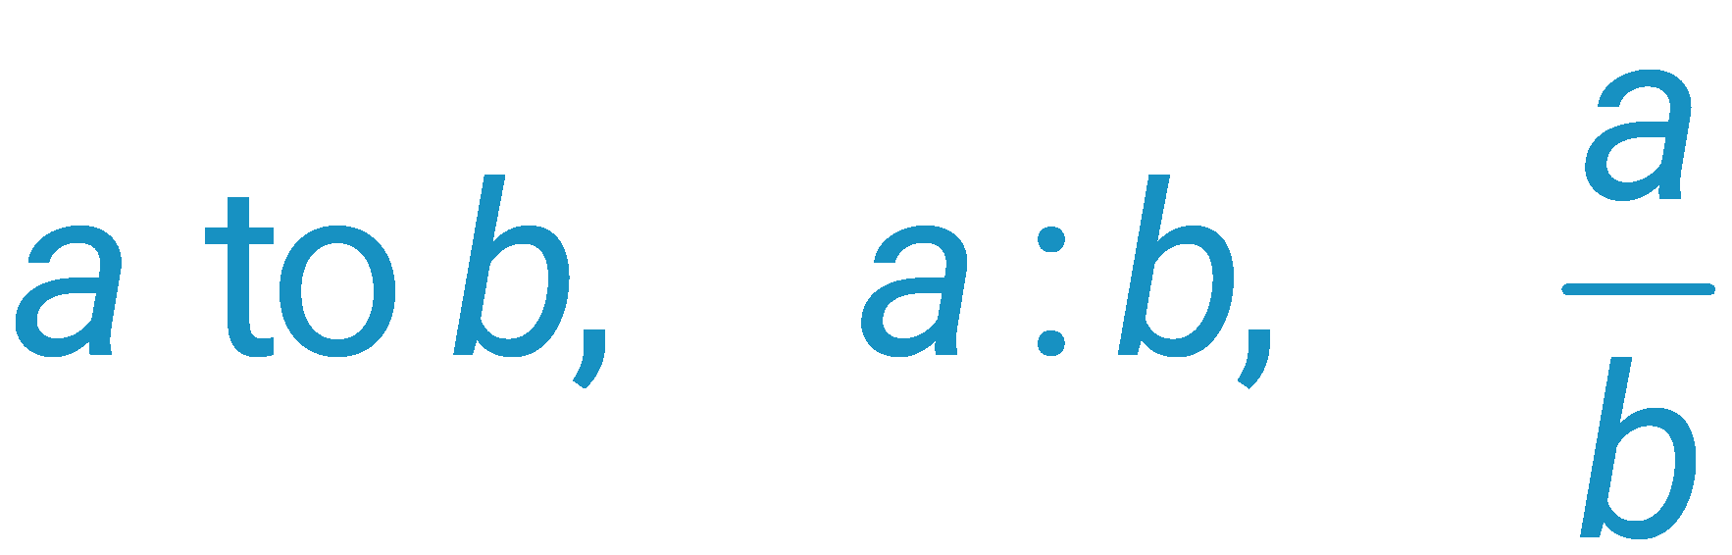
Define a Ratio
A ratio is a quotient of two quantities that is used to compare the quantities.
The ratio of the number a to the number b is written in any of the following ways.
All are pronounced “a to b” or “a is to b.”
This last way of writing a ratio is most common in mathematics, while a:b is perhaps more common in business.
4.4- ‹#›

Slide 3

Example
Write a ratio in the form a/b for each word phrase. Notice in each example that the number mentioned first is always the numerator.
(a) The ratio of 5 hours to 3 hours is

Slide 4

Example
(b) Find the ratio of 5 hours to 3 days.
  First convert 3 days to hours. 24 hours in 1 day, 3 days = 3 • 24 = 72 hours
  The ratio of 5 hours to 3 days is the quotient of 5 and 72.

Slide 5
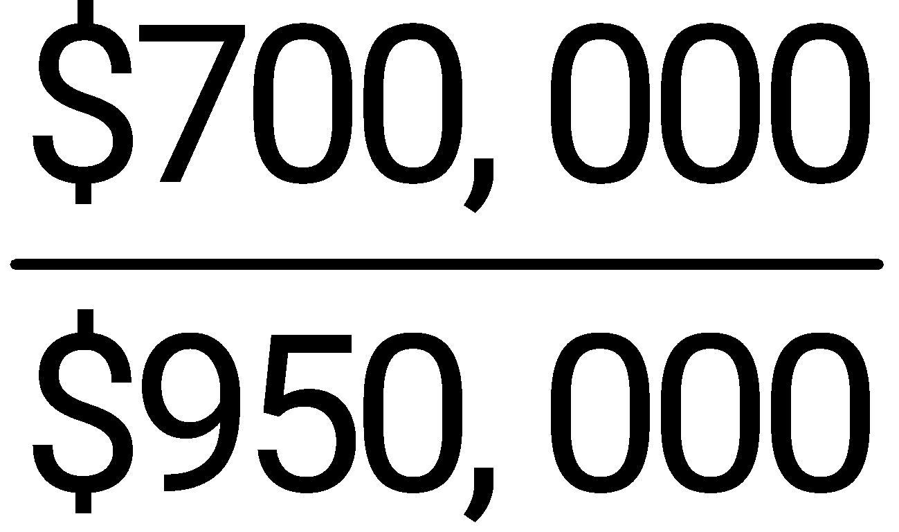
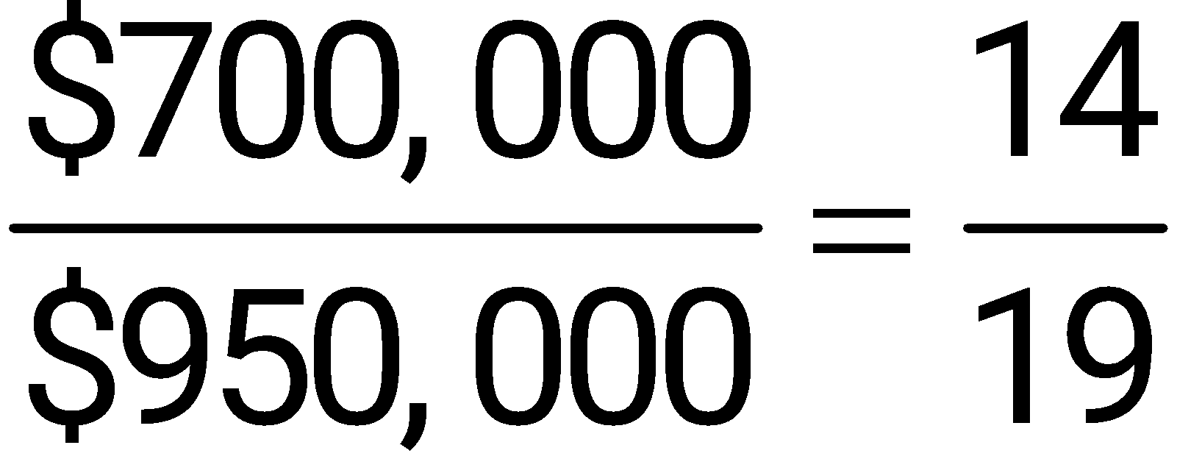
Example
(c) The ratio of $700,000 in sales to $950,000 in sales is written this way.
  Reduce to write this ratio in lowest terms.

Slide 6
Example
Burger King sold the following items in a one-hour period last Friday afternoon.
70 bacon cheeseburgers
15 plain hamburgers
30 salad combos
45 chicken sandwiches
40 fish sandwiches

Slide 7
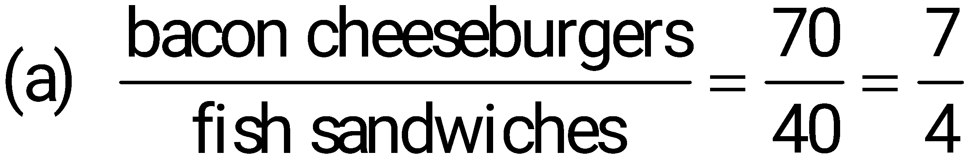
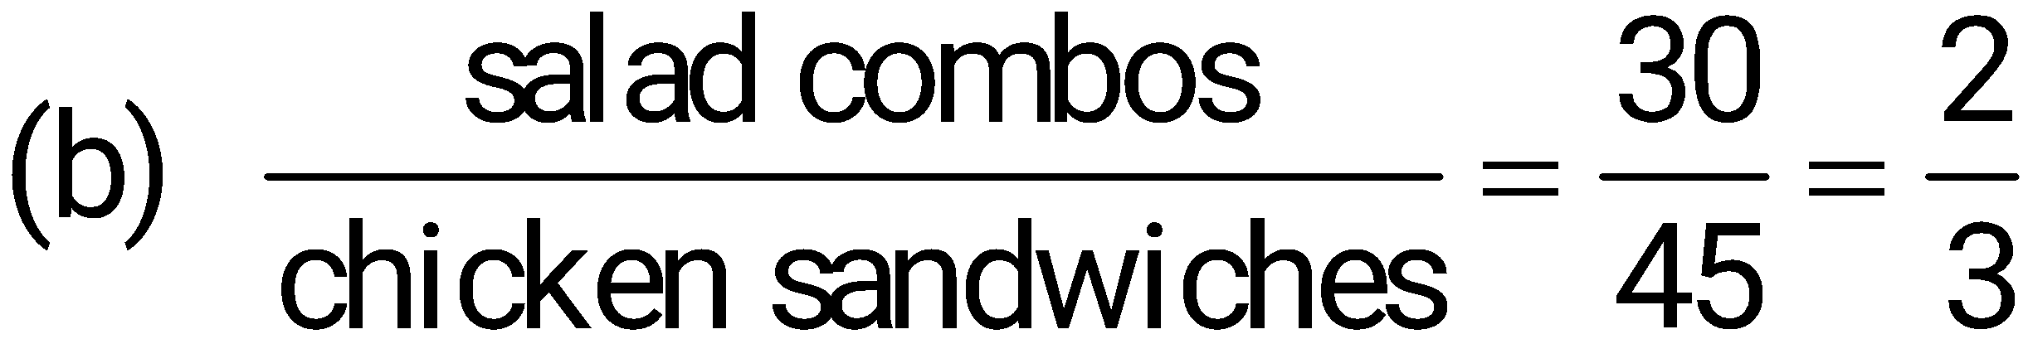
Example
Write ratios for the following items sold:
bacon cheeseburgers to fish sandwiches
(b) salad combos to chicken sandwiches

Slide 8
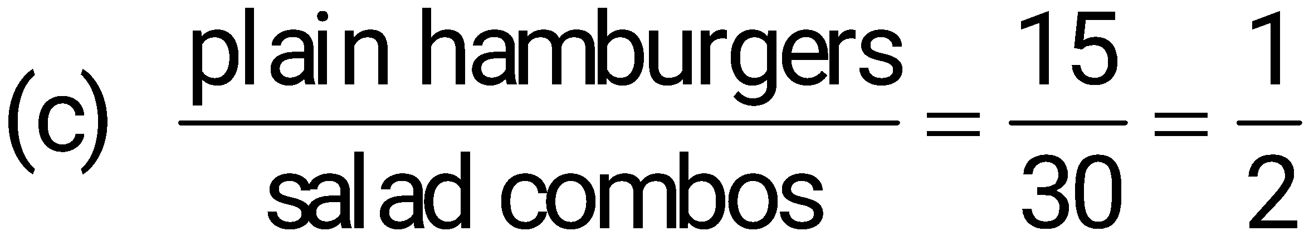
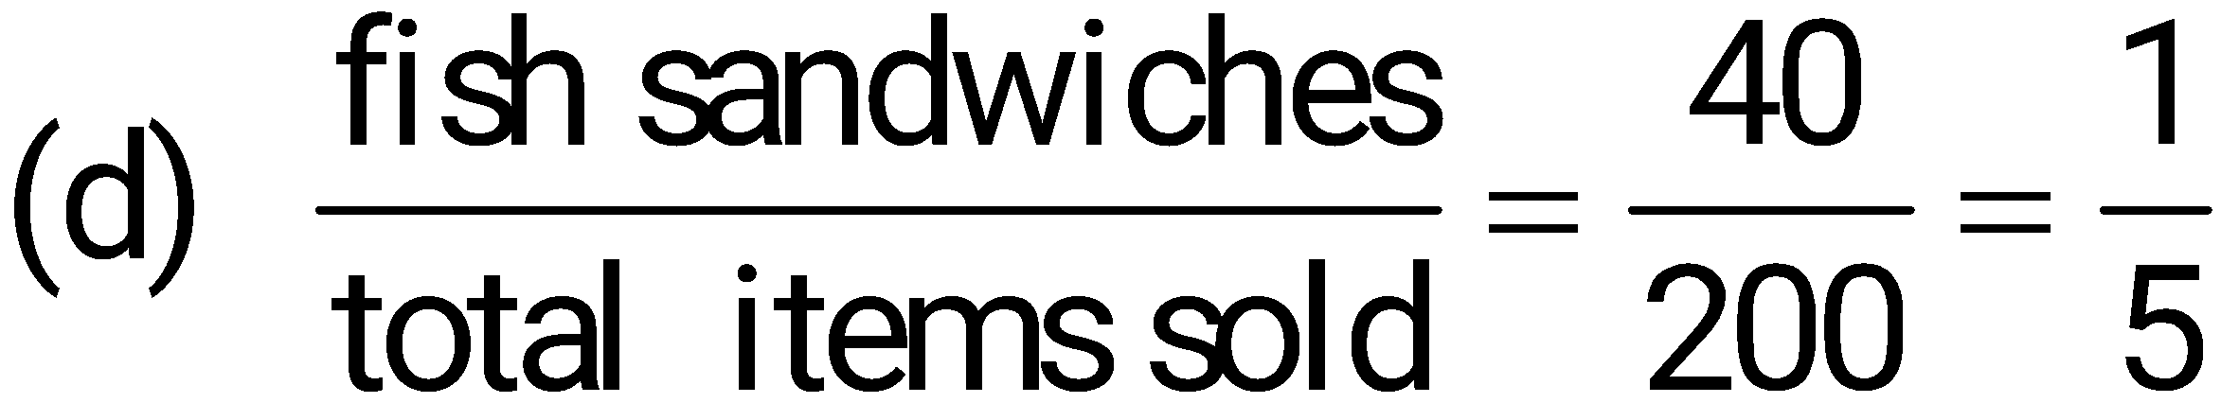
Example
Write ratios for the following items sold:
(c) plain hamburgers to salad combos
(d) fish sandwiches to total items sold

Slide 9
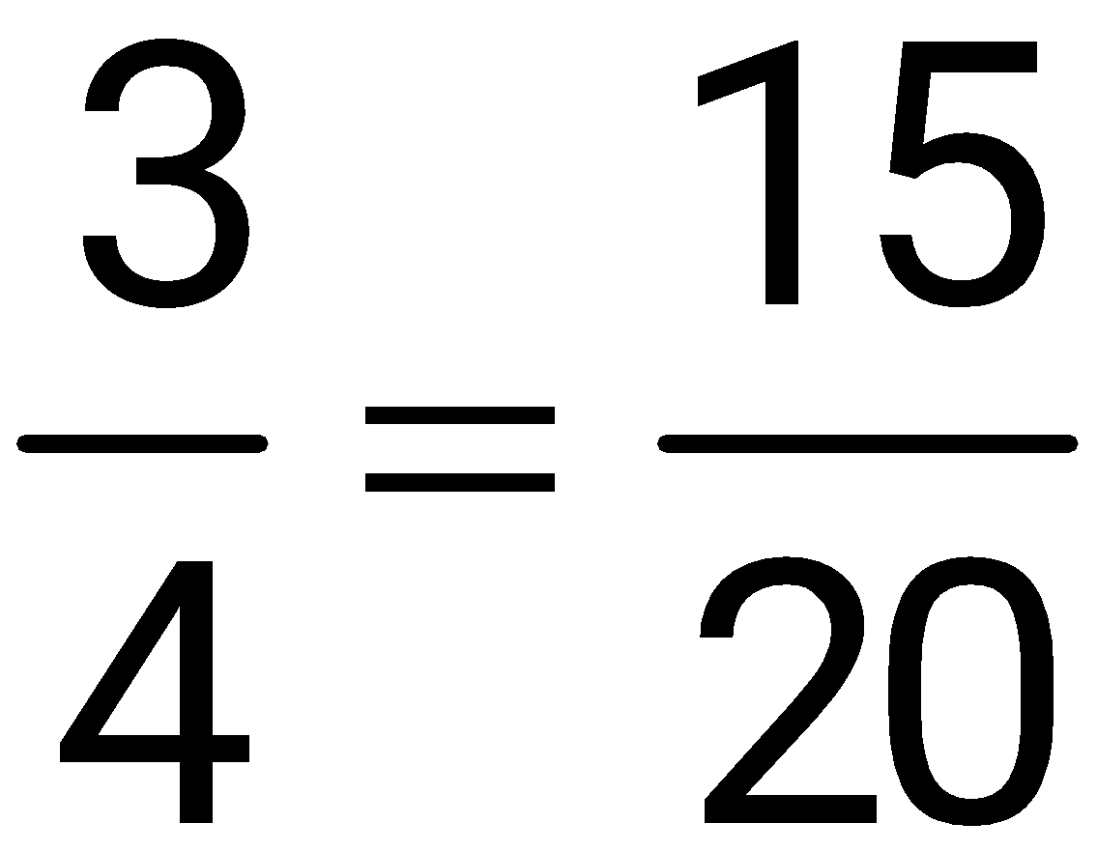
Set Up a Proportion
A ratio is used to compare two numbers or amounts.
A proportion says that two ratios are equal.

Slide 10
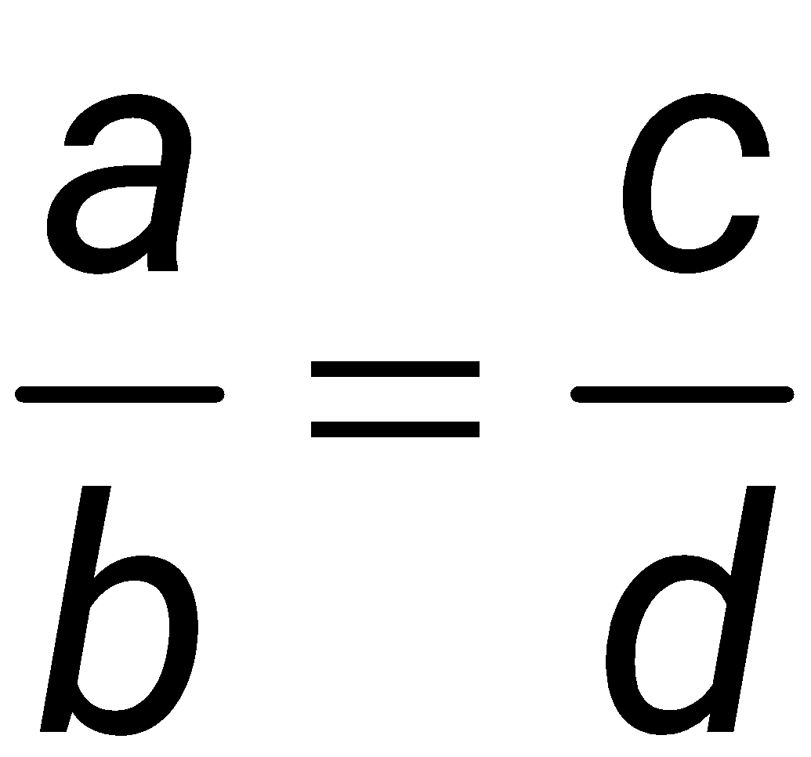
Method of Cross Products
The proportion
is true if the cross products a • d and b • c are equal (that is, if ad = bc).

Slide 11
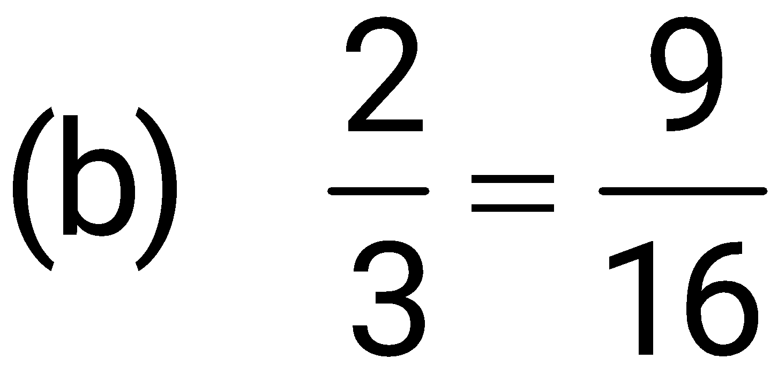
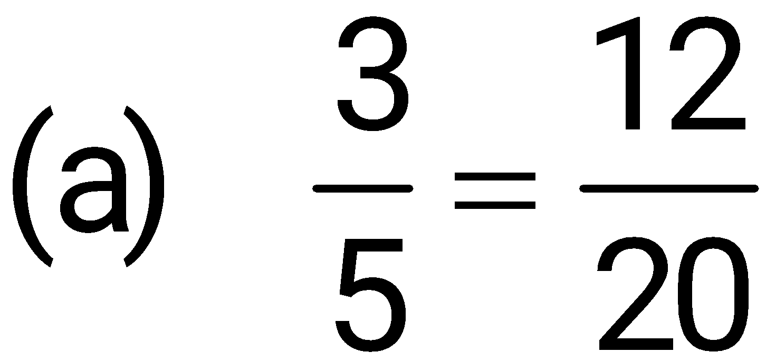
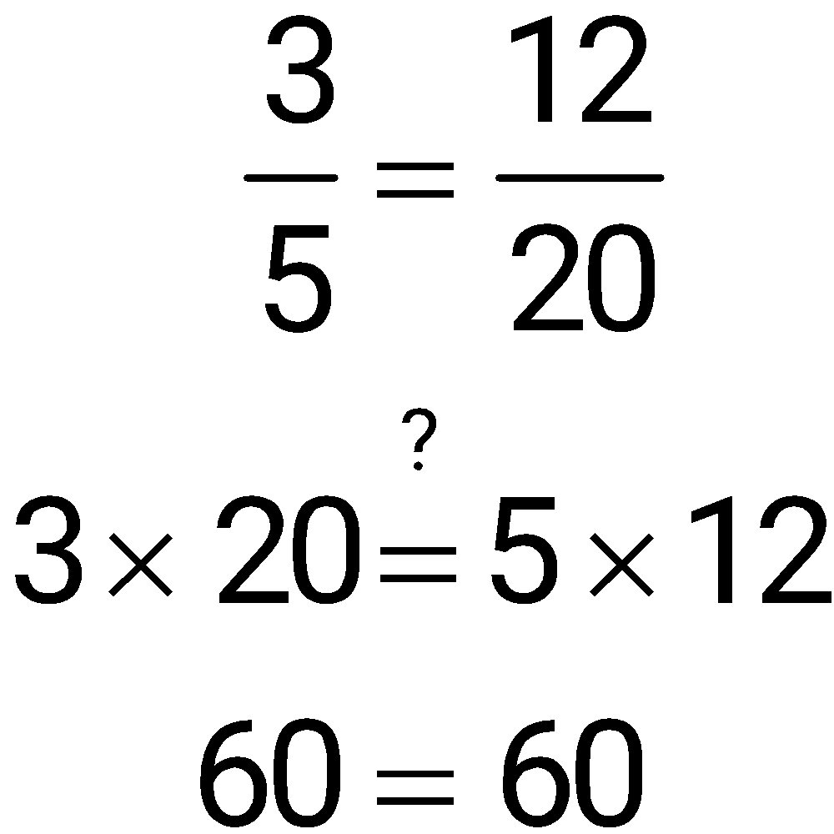
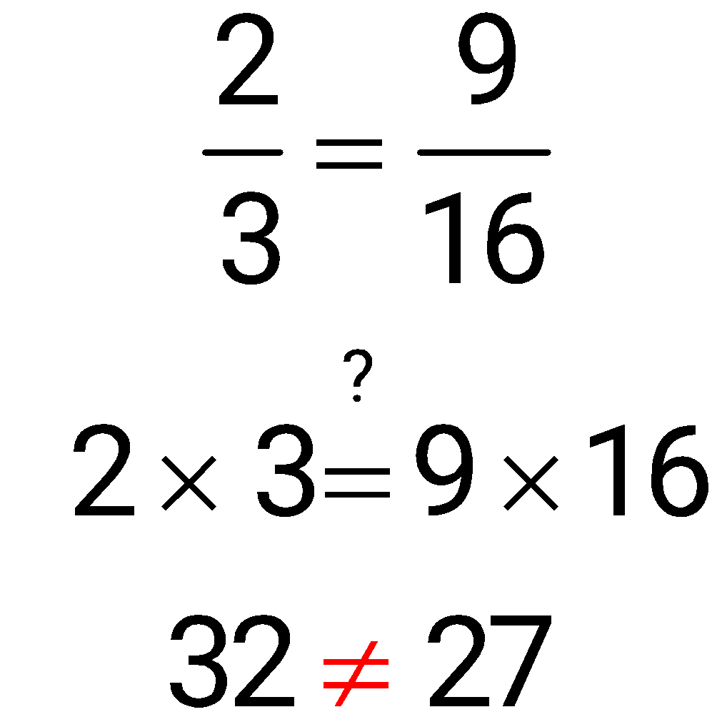
Example
Decide whether the following proportions are true.
True
False

Slide 12
Solve a Proportion for Unknown Values
Four numbers and/or variables are used in a proportion.
If any three of the values are known, the fourth can be found.
The two methods to solve a proportion are:
1. Multiply both sides by the product of the two denominators or
2. Use the method of cross products.

Slide 13
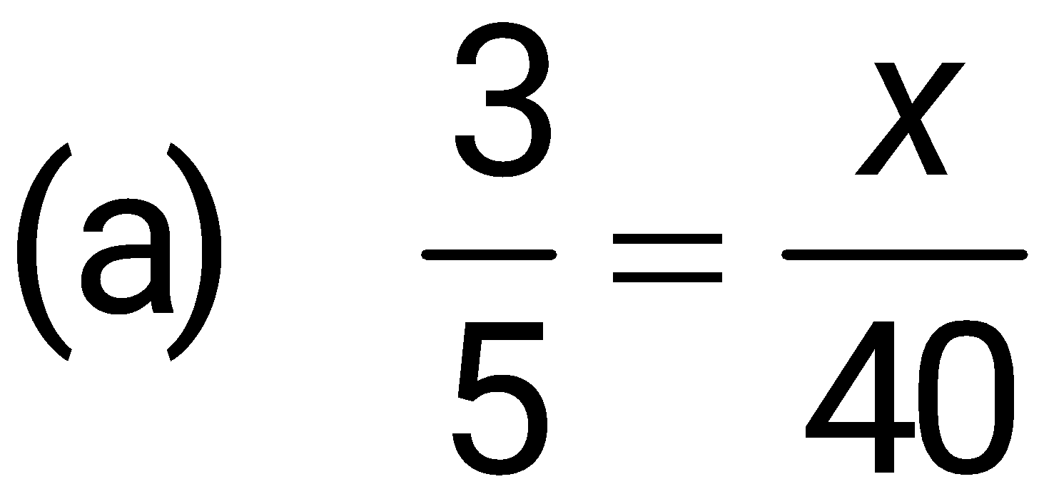
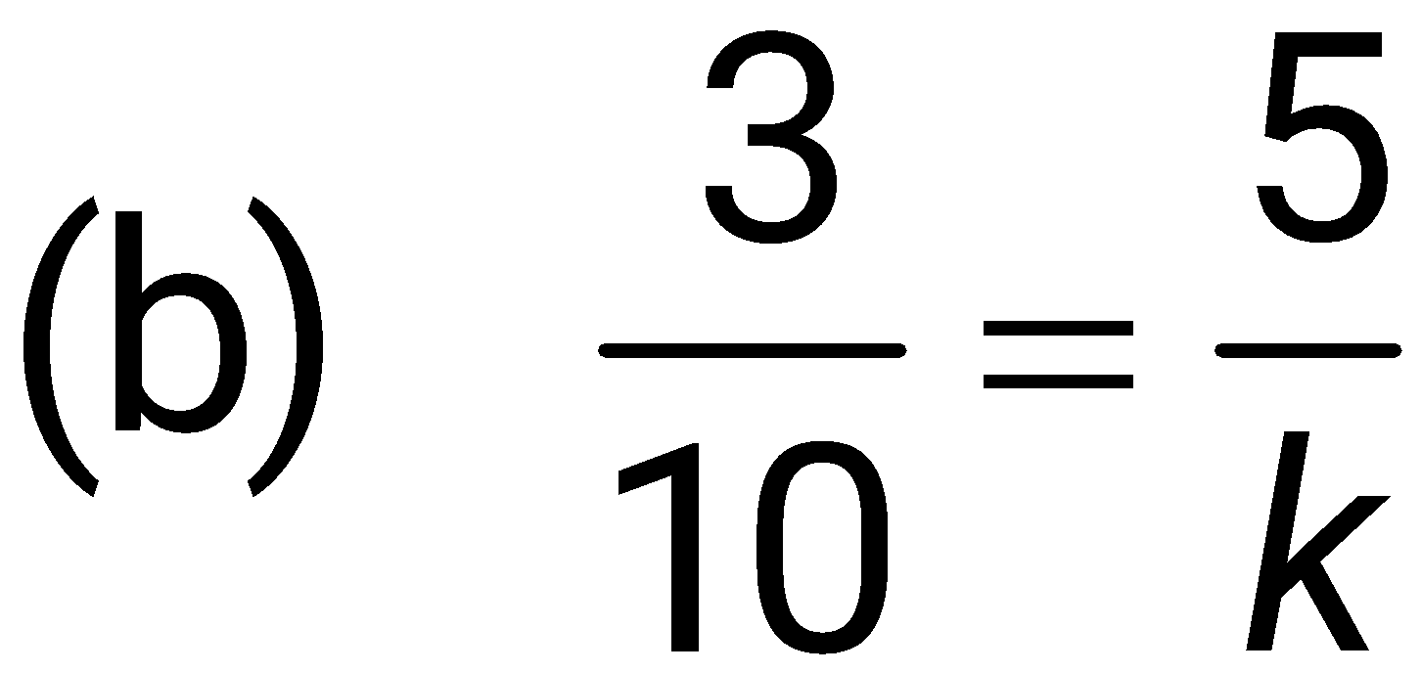
Example
Find the value of the unknowns. Use the first method for (a) and the second method for (b).

Slide 14
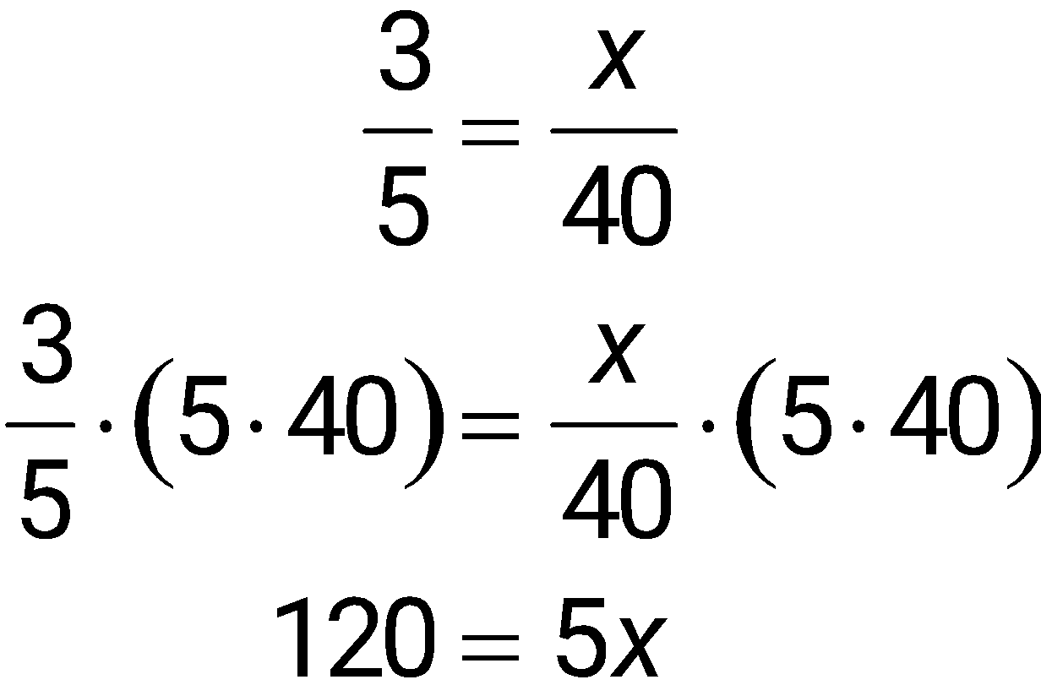
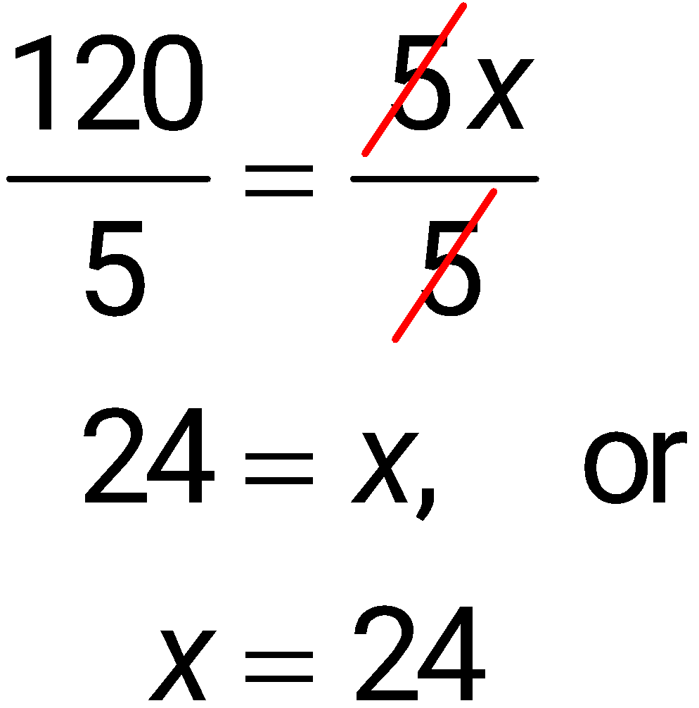
Example
(a) Solve for the unknown by multiplying both sides of the equation by the product of the denominators.

Slide 15
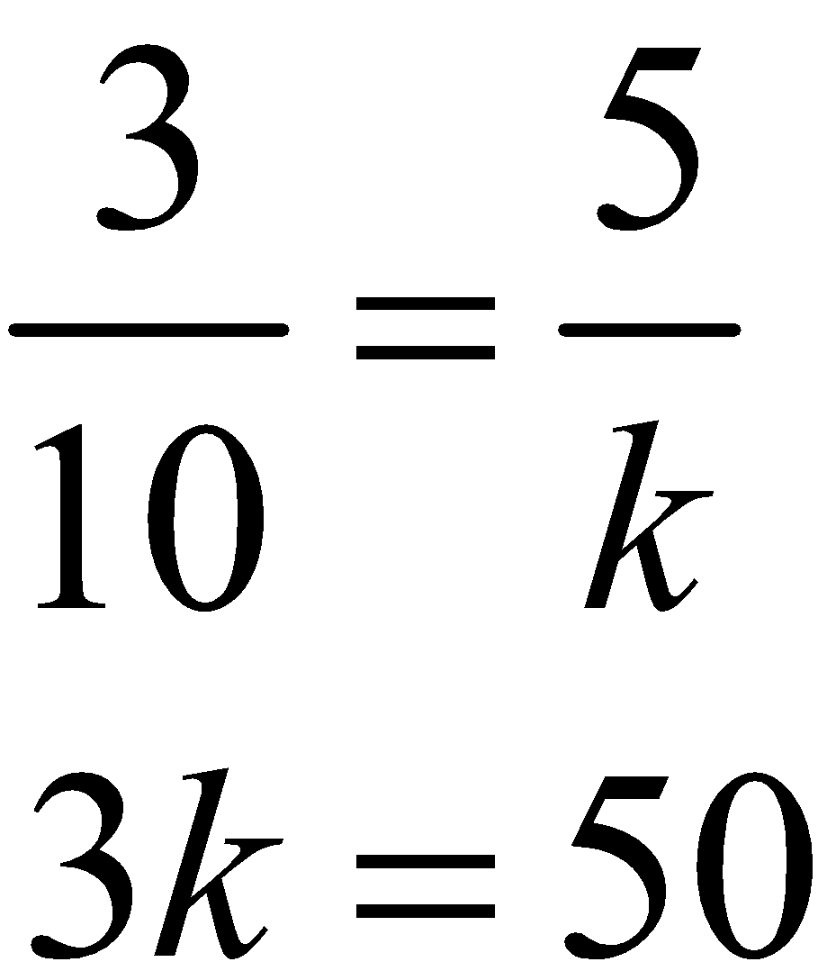
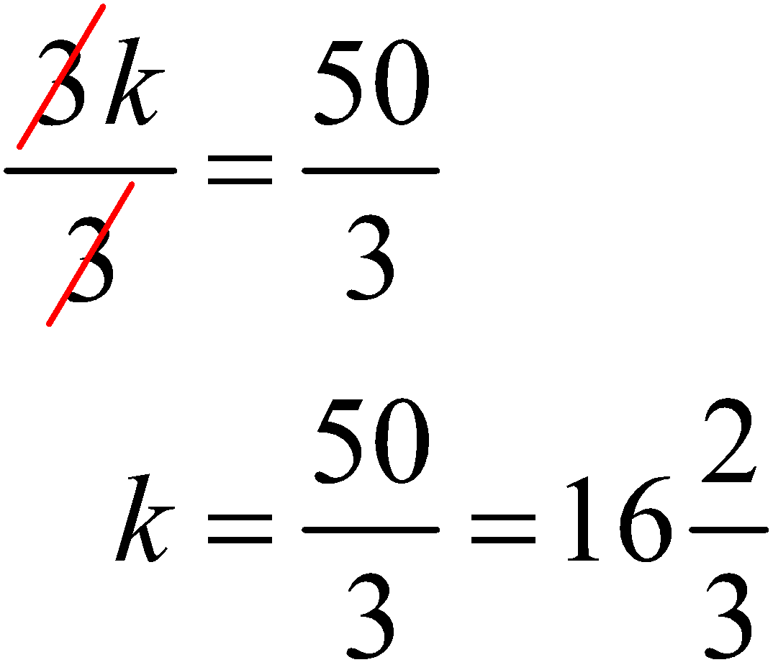
Example
(b) Solve for the unknown by using the method of cross products.

Slide 16
Example
A food wholesaler charges a restaurant chain $83 for 3 crates of fresh produce. How much should it charge for 5 crates of produce?

Slide 17
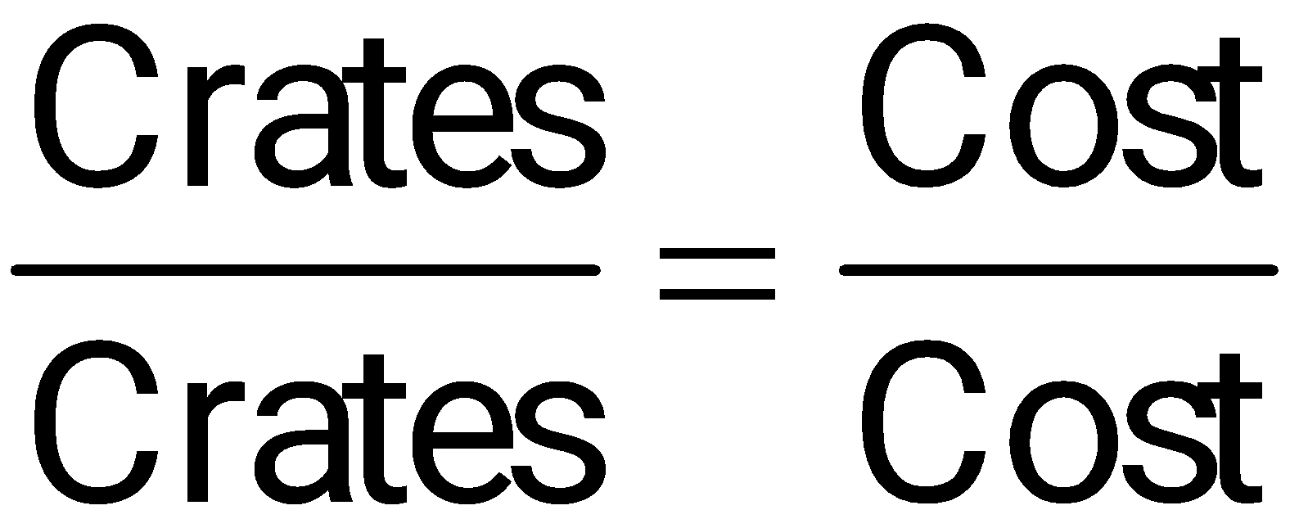
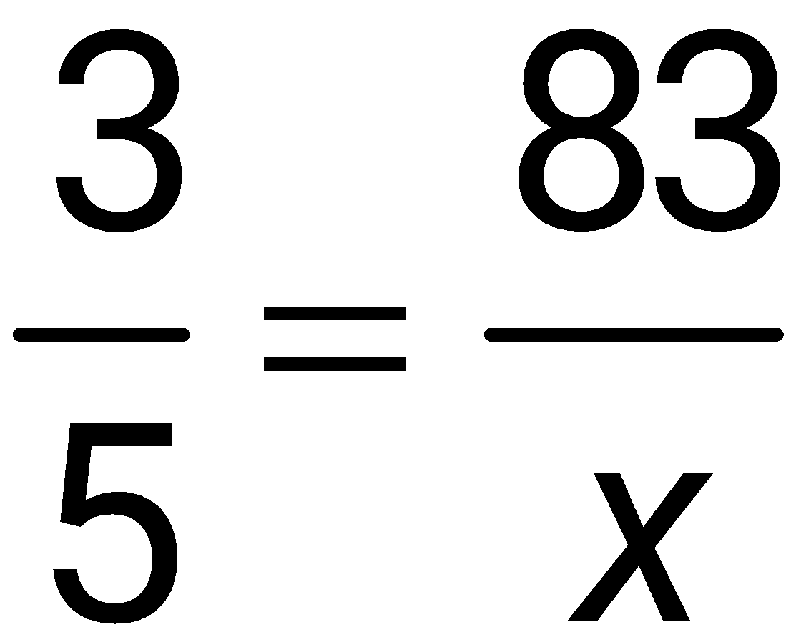
Example
Let x be the cost of 5 crates of produce. Set up a proportion with one ratio the number of crates and the other ratio the costs. Use this pattern.
Substitute the given information.

Slide 18
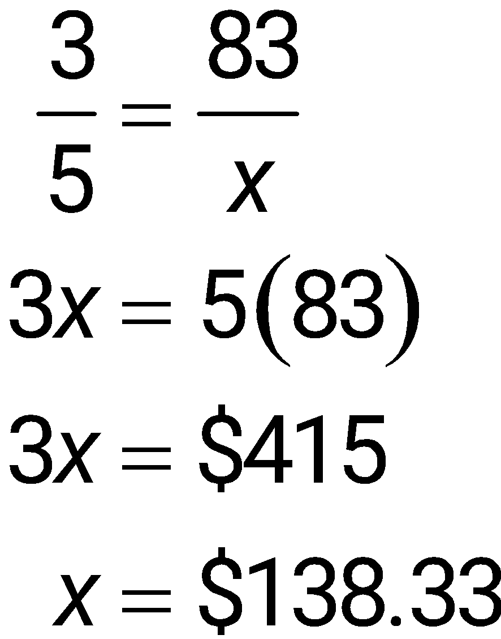
Example
Use cross products to solve the proportion.
The 5 crates cost $138.33.

Slide 19
Use Proportions to Solve Problems
Proportions are used in many practical applications.

Slide 20
Example
A firm in Hong Kong and one in Thailand agree to jointly develop an engine-control microchip to be sold to North American auto manufacturers. They agree to split the development costs in a ratio of 8:3 (Hong Kong firm to Thailand firm), resulting in a cost of $9,400,000 to the Hong Kong firm. Find the cost to the Thailand firm.

Slide 21
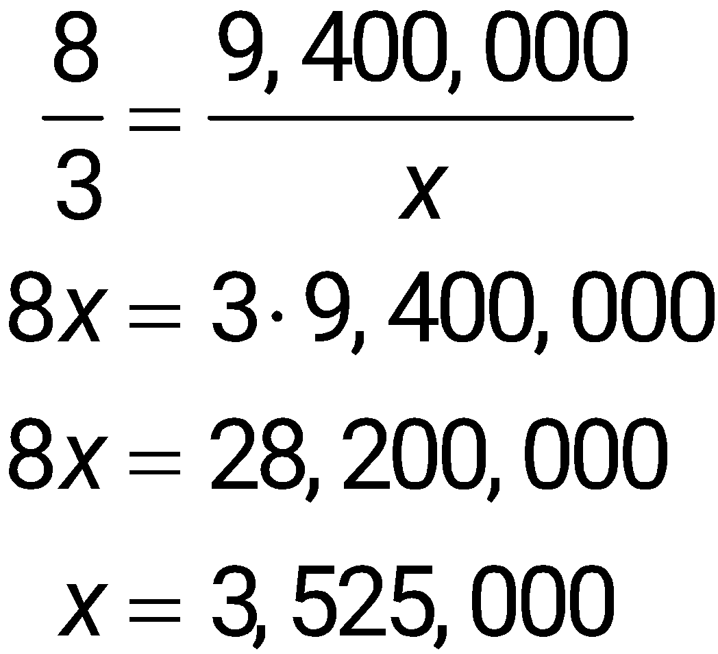
Example
Let x represent the cost to the Thailand firm, then
The Thailand firm’s share of the costs is $3,525,000.

Slide 22
Example
Bill Thomas wishes to estimate the amount of timber on some forested land that he owns. One value he needs to estimate is the average height of the trees. One morning, Thomas notices that his own 6-foot body casts an 8-foot shadow at the same time that a typical tree casts a 34-foot shadow. Find the height of the tree.

Slide 23
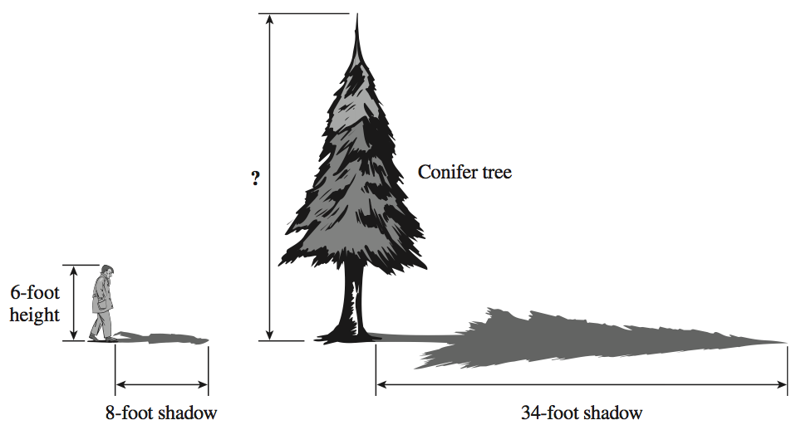
Example

Slide 24
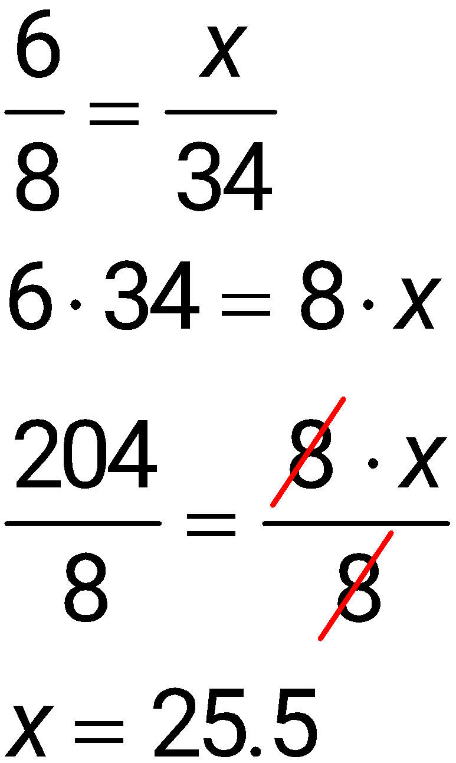
Example
Set up a proportion in which the height of the tree is given the variable name x.
The height of the tree is 25.5 feet.

